Slide 1
Water pollution
CAUSES,EFFECTS AND CONTROLS

Slide 2
Water pollution is defined as the presence in groundwater of toxic chemicals and biological agents that exceed what is naturally found in the water and may pose a threat to human health and/or the environment. Additionally, water pollution may consist of chemicals introduced into the water bodies as a result of various human activities.

Slide 3
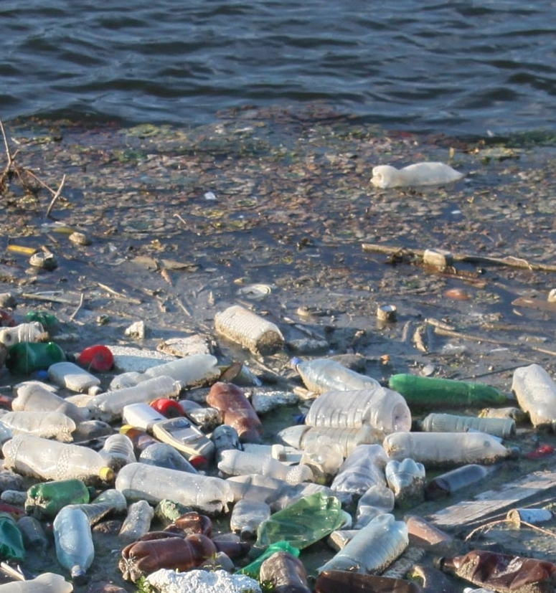

Slide 4
Sources Of Water Pollution
The key causative of water pollution in India are:
Urbanization.
Deforestation.
Industrial effluents.
Social and Religious Practices.
Use of Detergents and Fertilizers.
Agricultural run-offs- Use of insecticides and pesticides.

Slide 5
Effects Of Water Pollution
The effect of water pollution depends upon the type of pollutants and their concentration. Also, the location of water bodies is an important factor to determine the levels of pollution.
Water bodies in the vicinity of urban areas are extremely polluted. This is the result of dumping garbage and toxic chemicals by industrial and commercial establishments.
Water pollution drastically affects aquatic life. It affects their metabolism, and behaviour, and causes illness and eventual death. Dioxin is a chemical that causes a lot of problems from reproduction to uncontrolled cell growth or cancer. This chemical is bioaccumulated in fish, chicken and meat. Chemicals such as this travel up the food chain before entering the human body.
The effect of water pollution can have a huge impact on the food chain. It disrupts the food chain. Cadmium and lead are some toxic substances, these pollutants upon entering the food chain through animals (fish when consumed by animals, humans) can continue to disrupt at higher levels.
Humans are affected by pollution and can contract diseases such as hepatitis through faecal matter in water sources. Poor drinking water treatment and unfit water can always cause an outbreak of infectious dieseas such as cholera, etc.
The ecosystem can be critically affected, modified ,destroyed because of water pollution.

Slide 6
Control Measures of Water Pollution
Water pollution, to a larger extent, can be controlled by a variety of methods. Rather than releasing sewage waste into water bodies, it is better to treat them before discharge. Practising this can reduce the initial toxicity and the remaining substances can be degraded and rendered harmless by the water body itself. If the secondary treatment of water has been carried out, then this can be reused in sanitary systems and agricultural fields.
A very special plant, the Water Hyacinth can absorb dissolved toxic chemicals such as cadmium and other such elements. Establishing these in regions prone to such kinds of pollutants will reduce the adverse effects to a large extent.

